Slide 1
Mini Project Sem III
Desktop Virtual Voice Assistant using Python

Slide 2
Members of our Project Group:
Bhabal Rohan Ravindra (312010)
Bijapur Azim Ahmed Muktar Ahmed (312011)
Khan Arkaan Faizad (312021)
Shaikh Abuzar Hafizuddin (312041)

Slide 3
Introduction:
In this project we have designed a desktop virtual voice assistant using python and its modules.
We have named it Alex (just for fun to call it: younger brother of Alexa).
User is expected to just give a voice command and the assistant will execute those tasks.
The application uses the microphone as the source to receive the audio input and it then converts the speech to text query which is then fed to our functions which then perform the required task using different modules.
Mainly we can classify these commands into three types: web related, system related and questions. Here we intend to include all these types in our application.
We have aimed to automate nearly all the day to day life tasks that user needs to perform so as he can save time and be more efficient at work. The application does not use AI and Machine Learning algorithms.

Slide 4
Motivation:
We have many voice assistant in the market like Google assistant, Alexa etc. But a dark side of these assistants is that they tend to store user’s data and use system mic continuously which may lead to cyber threats.
Our main motivation is to program a personalized voice assistant for automating the desktop which will be more secure and all its functioning will be in the hands of the user.
It will help the user to access nearly each and every useful file and application in the system .
So this program is capable of functioning without internet connectivity for queries related to the system which other assistant like Alexa are not able to do. It is also platform independent and can be run in any OS with slight modifications.

Slide 5
Capabilities:
• sending emails
• playing music
• opening code editors
• opening MS Office applications
• opening YouTube
• opening folders
• opening Google
• searching on Wikipedia
• getting the weather news

Slide 6
Hardware Requirements:
➢ x86 64-bit CPU (Intel / AMD architecture)
➢ 4GB RAM
➢ 5 GB Disk Space

Slide 7
Software Requirements:
➢ Windows 7 or 10
➢ Mac OS X 10.11 or higher 5
➢ Linux: RHEL 6/7
➢ Python 3.10.0 ➢ Visual Studio Code (IDE)
➢ Important Python Modules like:
pyttsx3 (converts text to speech)
speech recognition (converts speech to text )
sapi5 (software development kit by Microsoft )
datetime(to get the current time )
Wikipedia (to access Wikipedia and search queries on it)
webbrowser (to access other websites)
os (to interact with the operating system)
Smtp lib (to send emails)

Slide 8
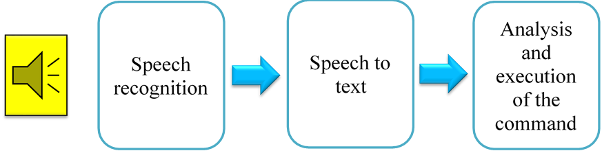
System design and working:

Slide 9
System design and working:
Takecommand() function:which makes use of Speech Recognition module to recognize the speech and convert it into a query string.
This query is then fed to other functions which then execute the commands
To enable the application take commands, we put all the functions (used else if for each) in an infinite while loop
speak() function :In order to make it speak something we must give it a text. This text is then converted to speech using pyttsx3 module. pyttsx3 engine is capable of converting text to speech and a say() function in it helps to speak whatever is being fed to it.
voices for our program is given by a software development kit developed by Microsoft called ‘sapi5’ which uses system voices for the purpose.

Slide 10
Algorithm and Process Design:
Start
Wait for a query from user
If
Execute the command
Good Bye
Execute query
End

Slide 11
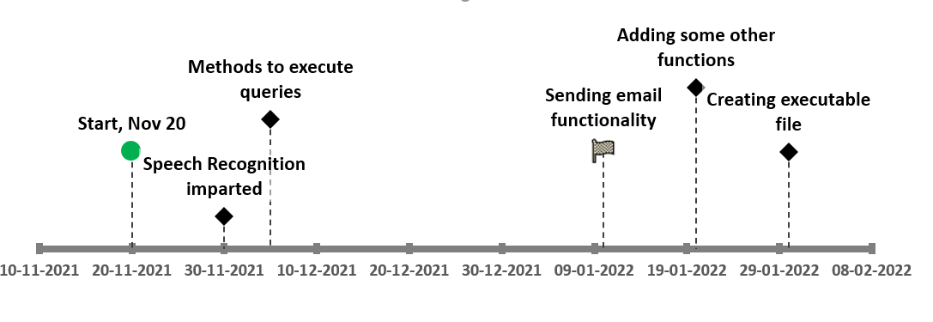
Timeline diagram of the work:

Slide 12
Future Scope:
What we have at the present is only a program that when run from the IDE would become our voice assistant.
So in the future one may add some GUI for the user using python libraries like Tkinter in order to make the assistant look more attractive and for ease of use of the user.
One may also create its runnable file at the desktop using ‘pyinstaller’ so as the user will be able to access it from the desktop itself.

Slide 13
Conclusion:
In this project we have presented the design and implementation of a virtual desktop assistant “Alex” which will be programmed merely using python. Using this application, we will be able to automate our desktop, access some important sites on the web and also ask queries to the assistant which it will answer referring to the Wikipedia. In short, this assistant will help us in being more productive at work and save time.

Slide 14
References:
Code with Harry – YouTube (https://www.youtube.com/channel/UCeVMnSShP_Iviwkknt83cww )
https://extrudesign.com/virtual-assistant-using-python/
Ravikumar , Prateek , Sathvik Bhandar, Rahul Kumar, Mayura D Tapkire “virtual voice assistant”,International Research Journal of Engineering and Technology(2020)
Python docs (https://www.python.org/doc/ )

Slide 15
Thank You

